Slide 1
Comparison of Machine Learning Algorithms
Predicting Credit Card Default using 1-NN, k-NN & Decision Trees
Yoon Phyo Ei Student ID: 101064264

Slide 2
Aims & Objectives
Aim:
To implement ML algorithms from scratch and evaluate their performance on UCI Default of Credit Card Clients dataset
Objectives:
Implementation: Develop vector-optimized 1-NN, k-NN and Decision Tree (CART) algorithms in Python.
Preprocessing: Develop a robust pipeline to handle class imbalance (22%) and feature scaling for financial data.
Optimization: Apply Tie-Breaking strategies and Hyperparameter Tuning to improve model stability.
Evaluation: Compute the accuracy of the models using a held-out test set.

Slide 3
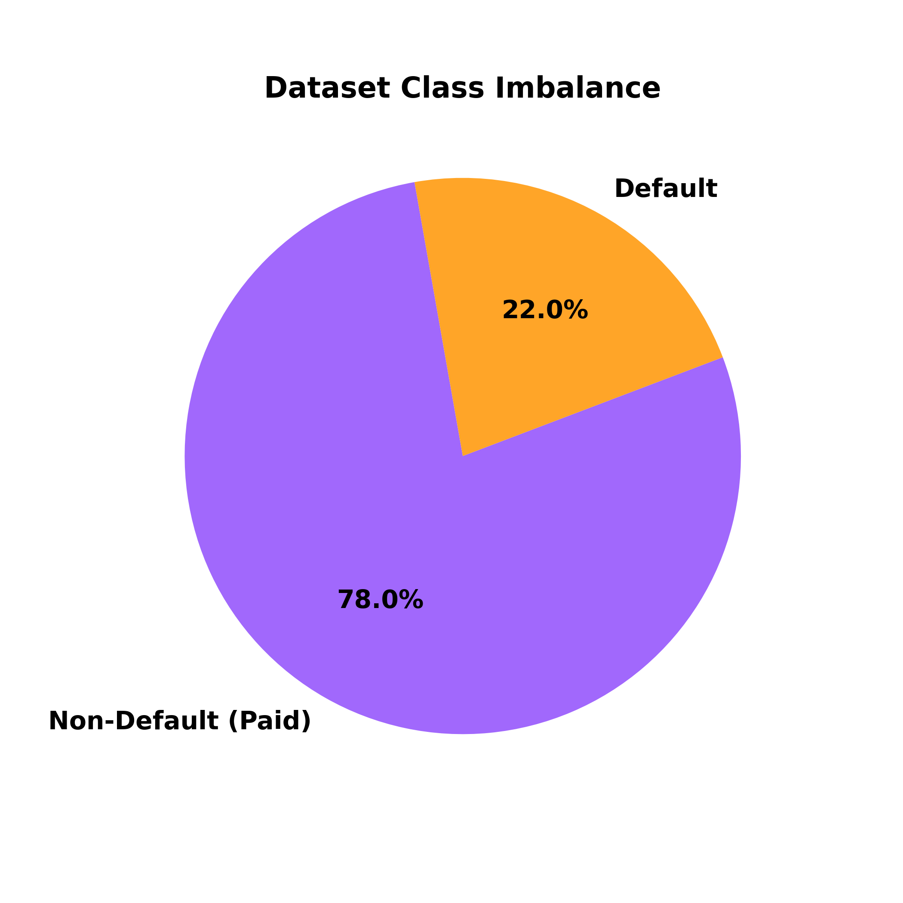
Default of Credit Card Clients Dataset
30,000 instances, 23 features
Limit Balance/Credit Limit
LIMIT_BAL
Demographics:
AGE, SEX, EDUCATION, MARRIAGE
Repayment Status
PAY_0 - PAY_6
Bill Amounts
BILL_AMT1 - BILL_AMT6
Previous Payment Amount
PAY_AMT1 - PAY_AMT6

Slide 4
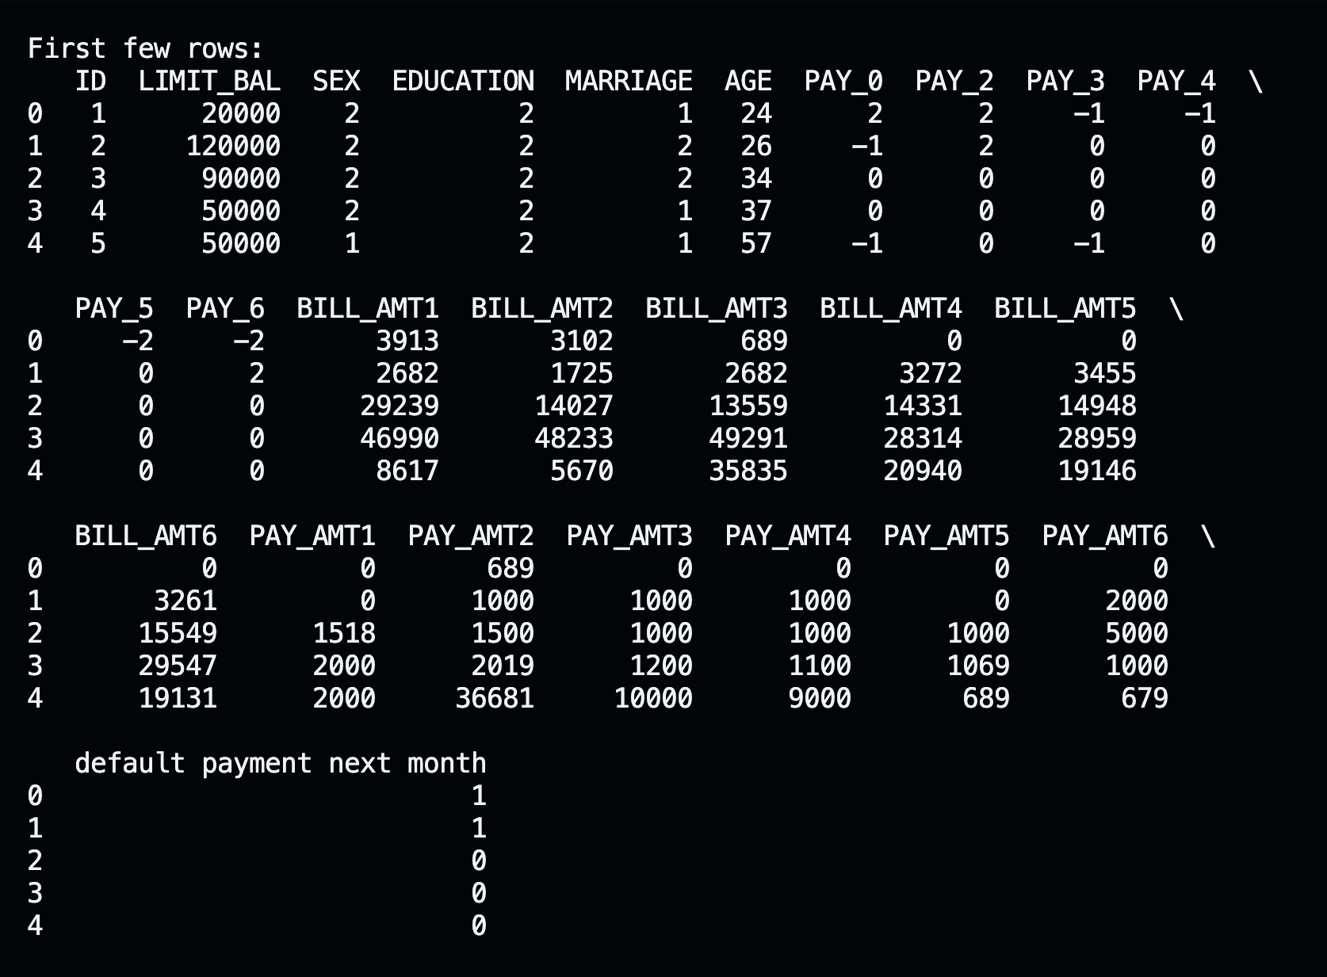
Feature Definitions
SEX: 1=male, 2=female
EDUCATION: 1=graduate school, 2=university, 3=high school, 4=others
MARRIAGE: 1=married, 2=single, 3=others
AGE: Age in years
PAY_0…PAY_6:
-2 = no consumption
-1 = paid the entire balance on time.
0 = paid the minimum amount required
1 = one month delay....8 = eight months delay

Slide 5
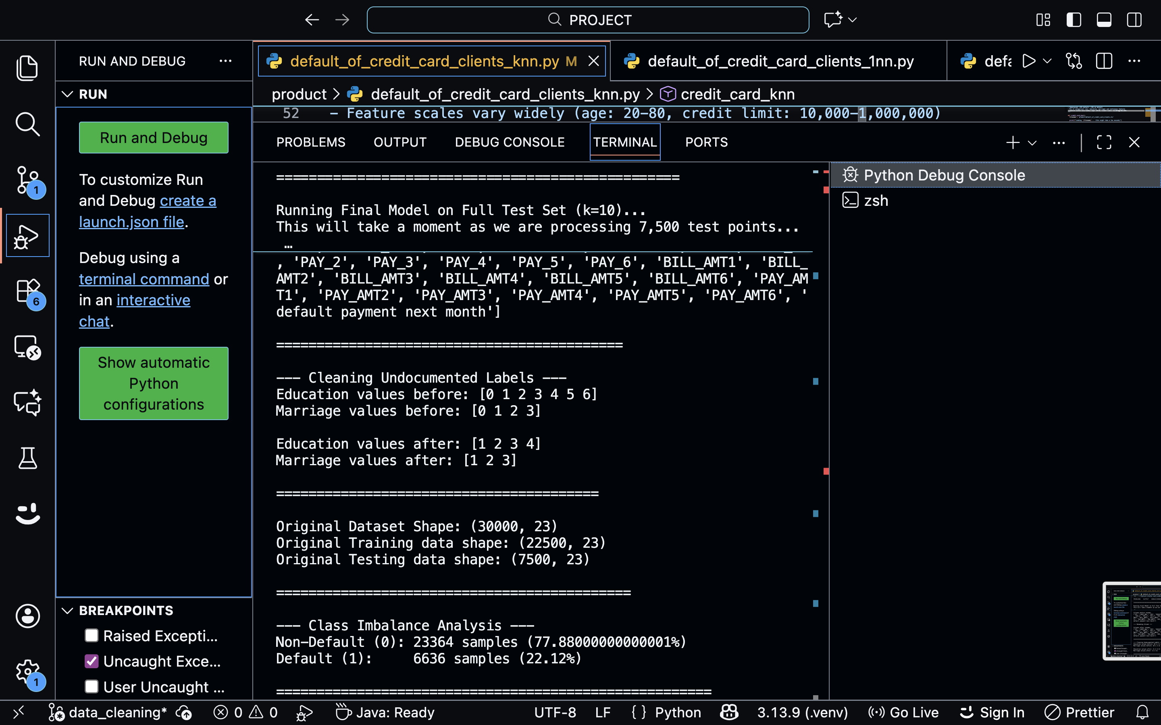
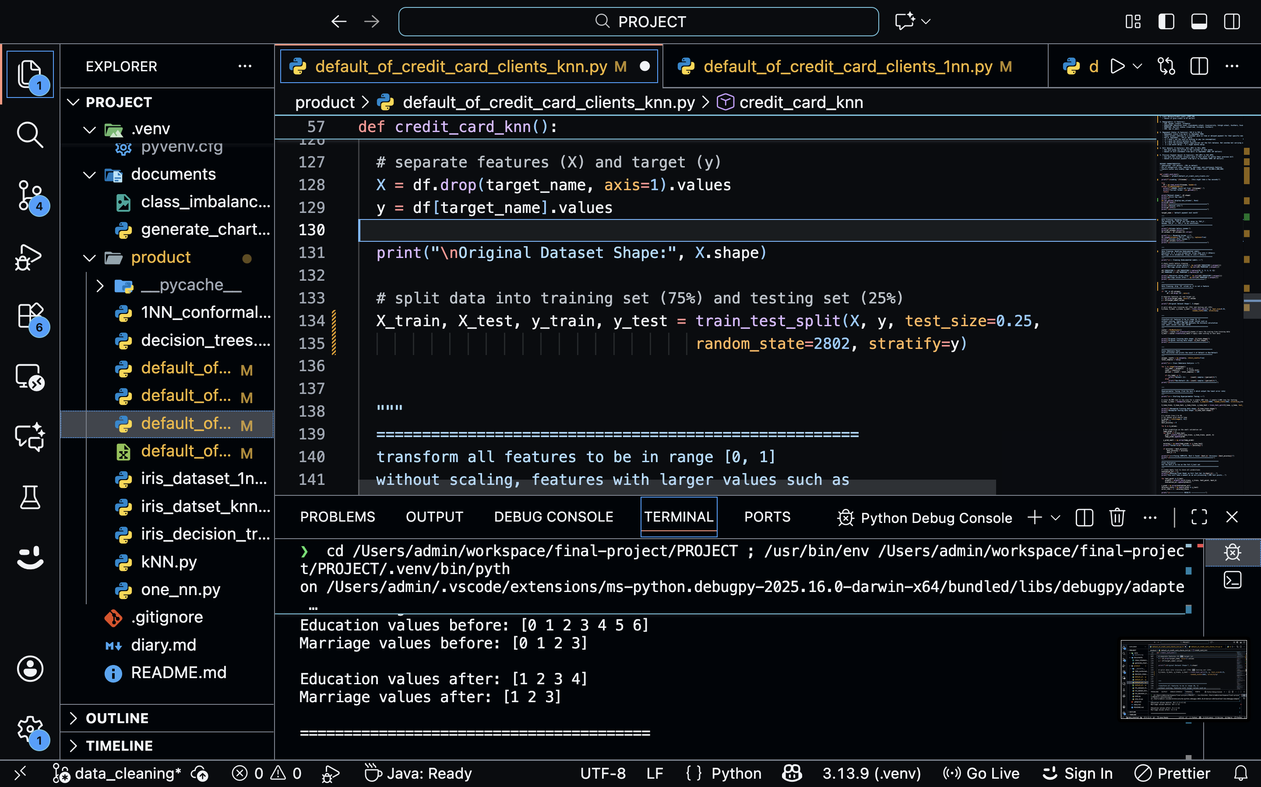
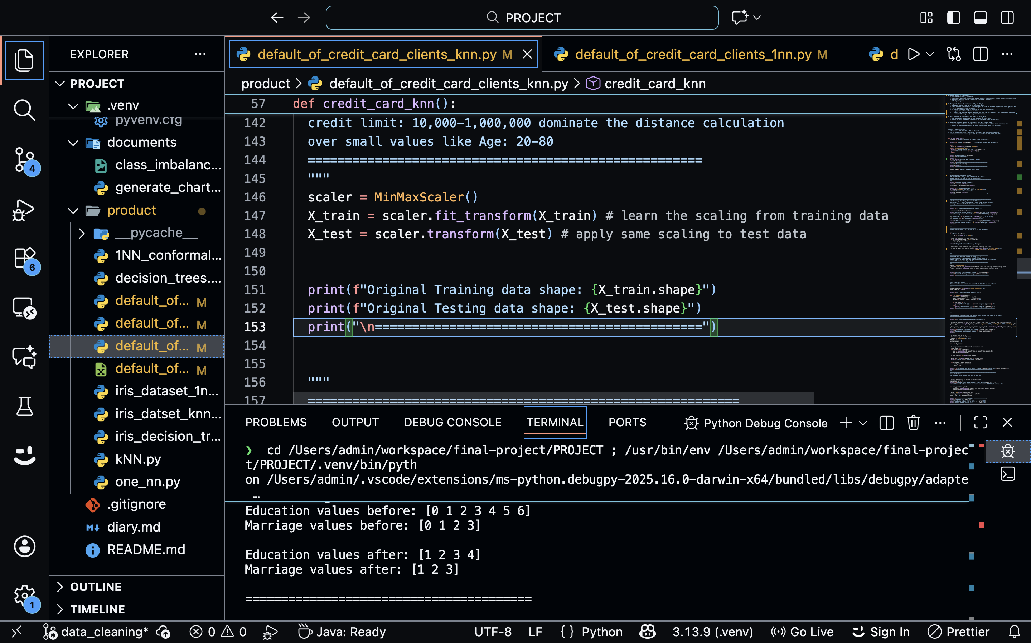
Preprocessing
Data Cleaning
Data Splitting:
Normalization
Mapped undocumented labels in Education (0, 5, 6) and Marriage (0) to the "Others" category
Renamed PAY_0 to PAY_1
Used a standard 75% Train / 25% Test split
Applied Stratified Splitting to maintain the 22% Default and 78% Non-Default class ratio
Features had vastly different scales e.g., LIMIT_BAL vs. AGE
Scaled all features to [0, 1] range for accurate distance calculation.

Slide 6

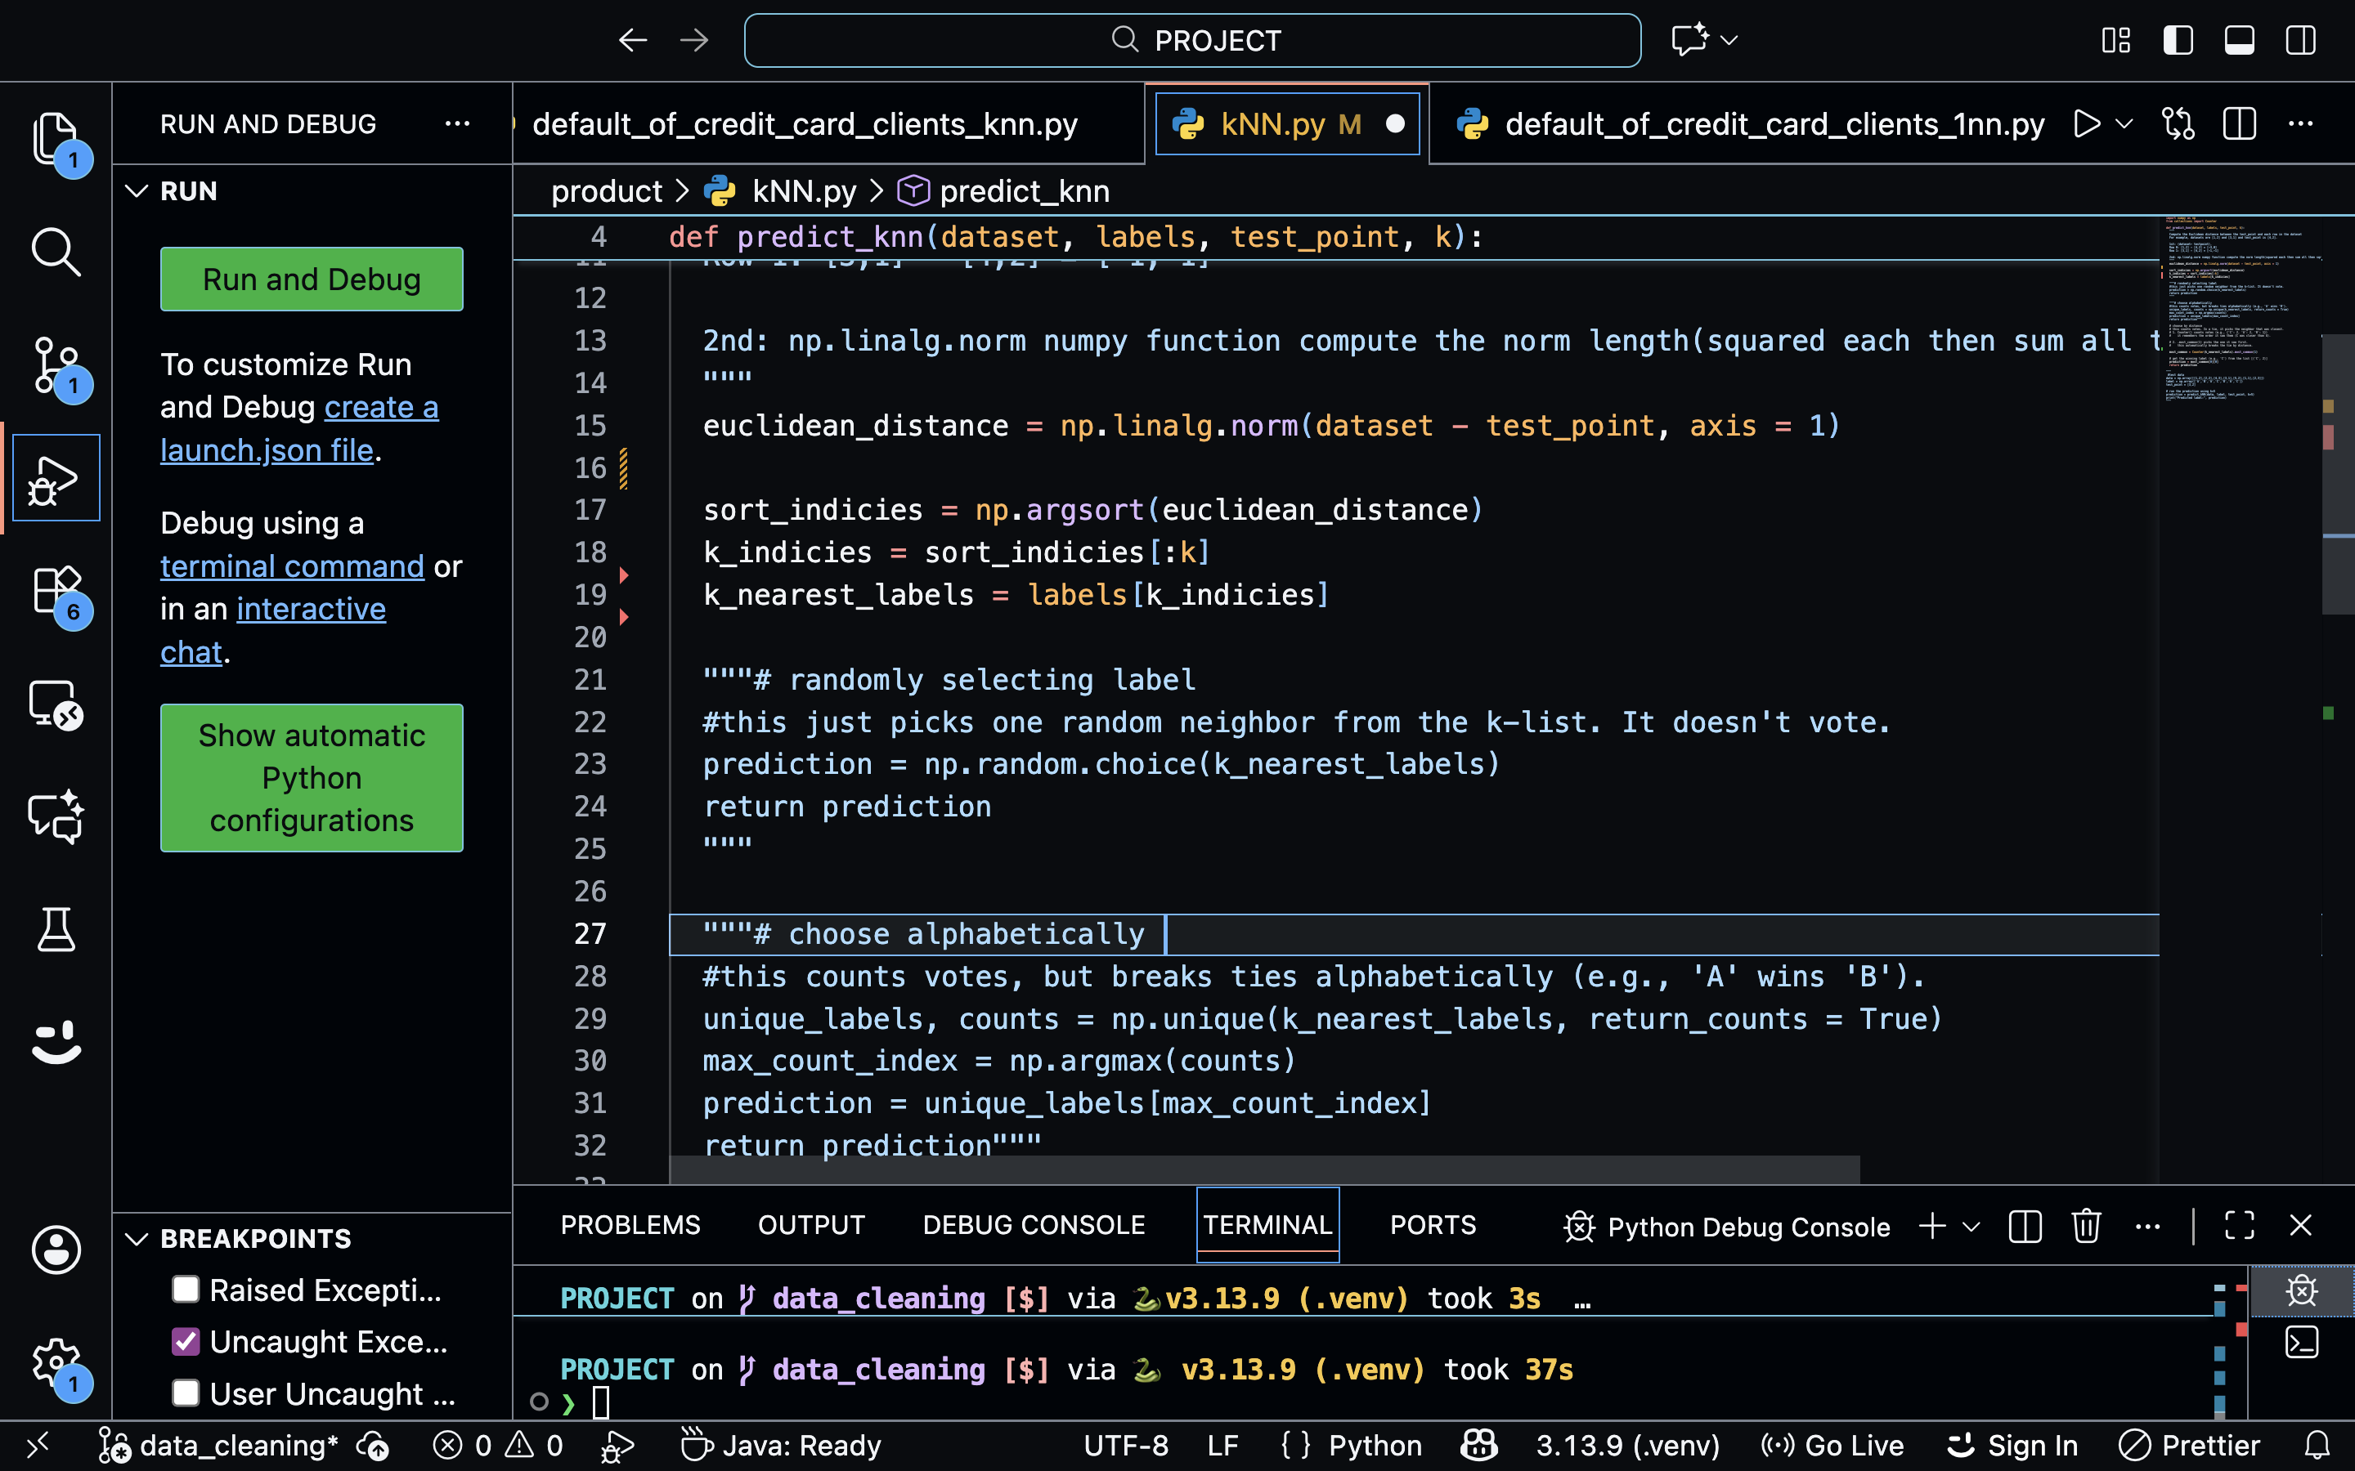
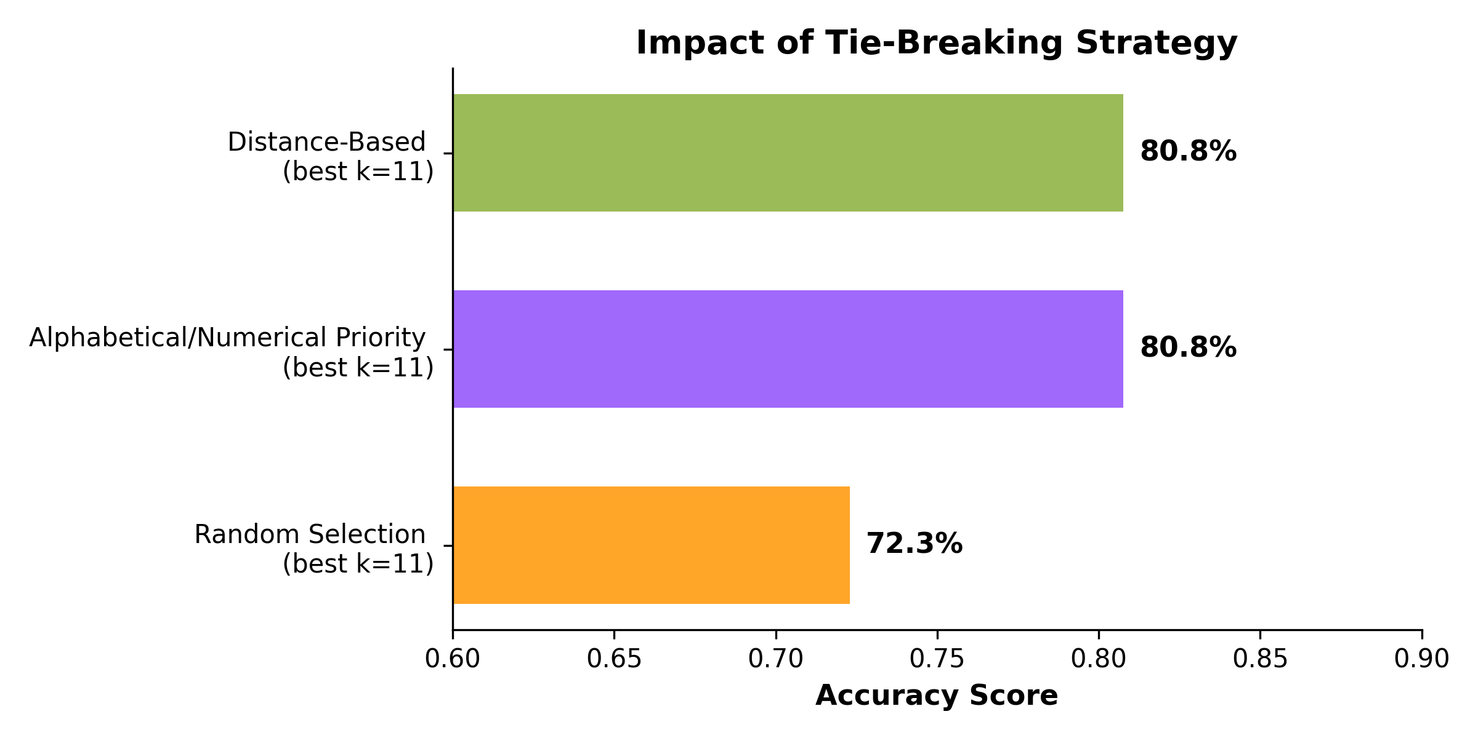
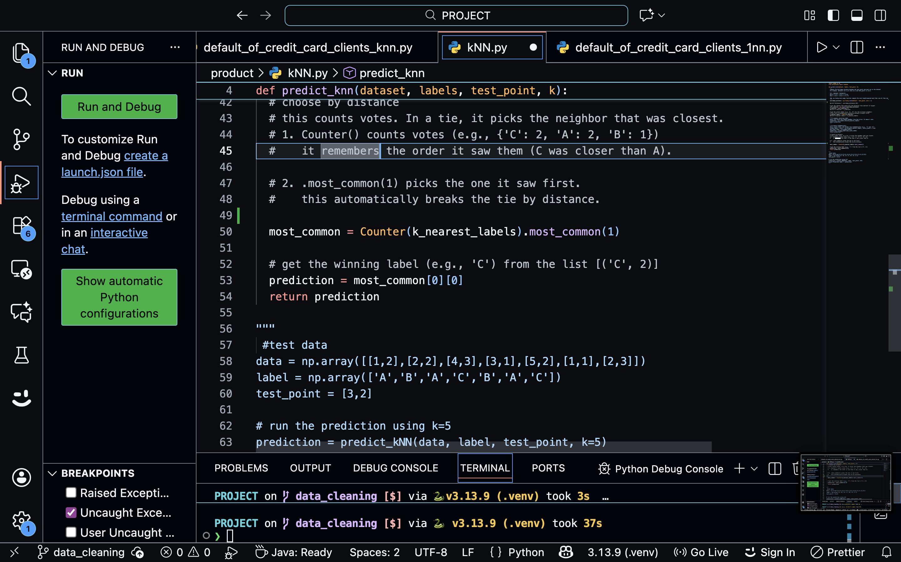
k-Nearest Neighbors Implementation
Vectorized Euclidean Distance
Distance-Based Tie-Breaking Strategy
Comparison of Tie-Breaking Methods

Slide 7
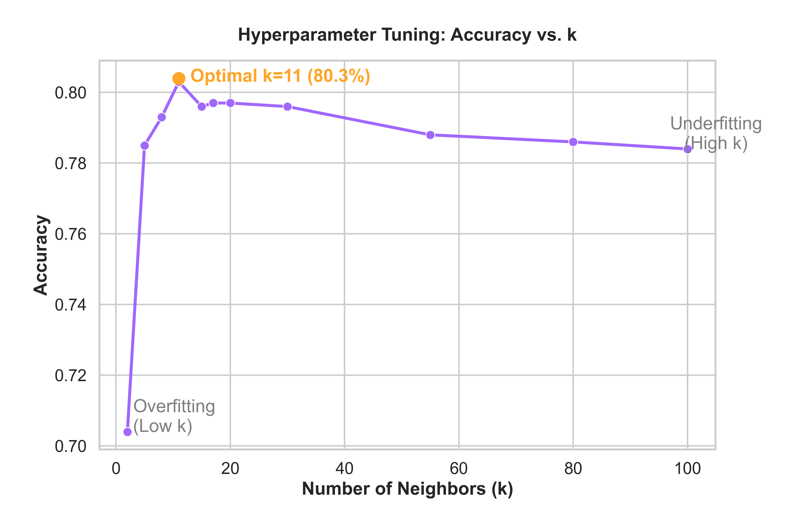
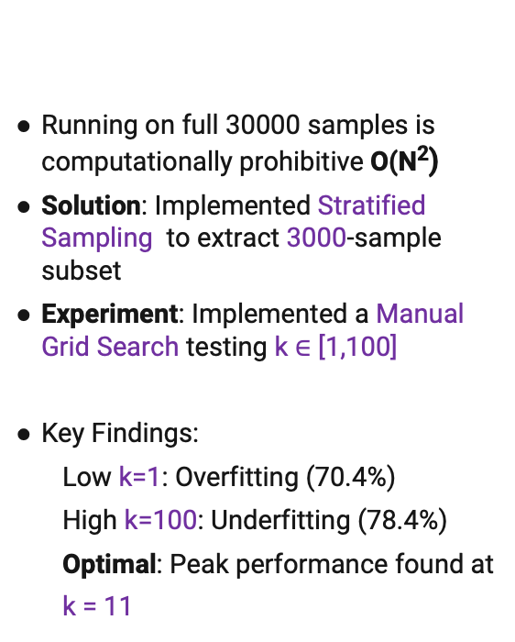
Hyperparameter Tuning
Running on full 30000 samples is computationally prohibitive O(N²)
Solution: Implemented Stratified Sampling to extract 3000-sample subset
Experiment: Implemented a Manual Grid Search testing k $∈$ [1,100]
Key Findings:
Low k=1: Overfitting (70.4%)
High k=100: Underfitting (78.4%)
Optimal: Peak performance found at
k = 11

Slide 8
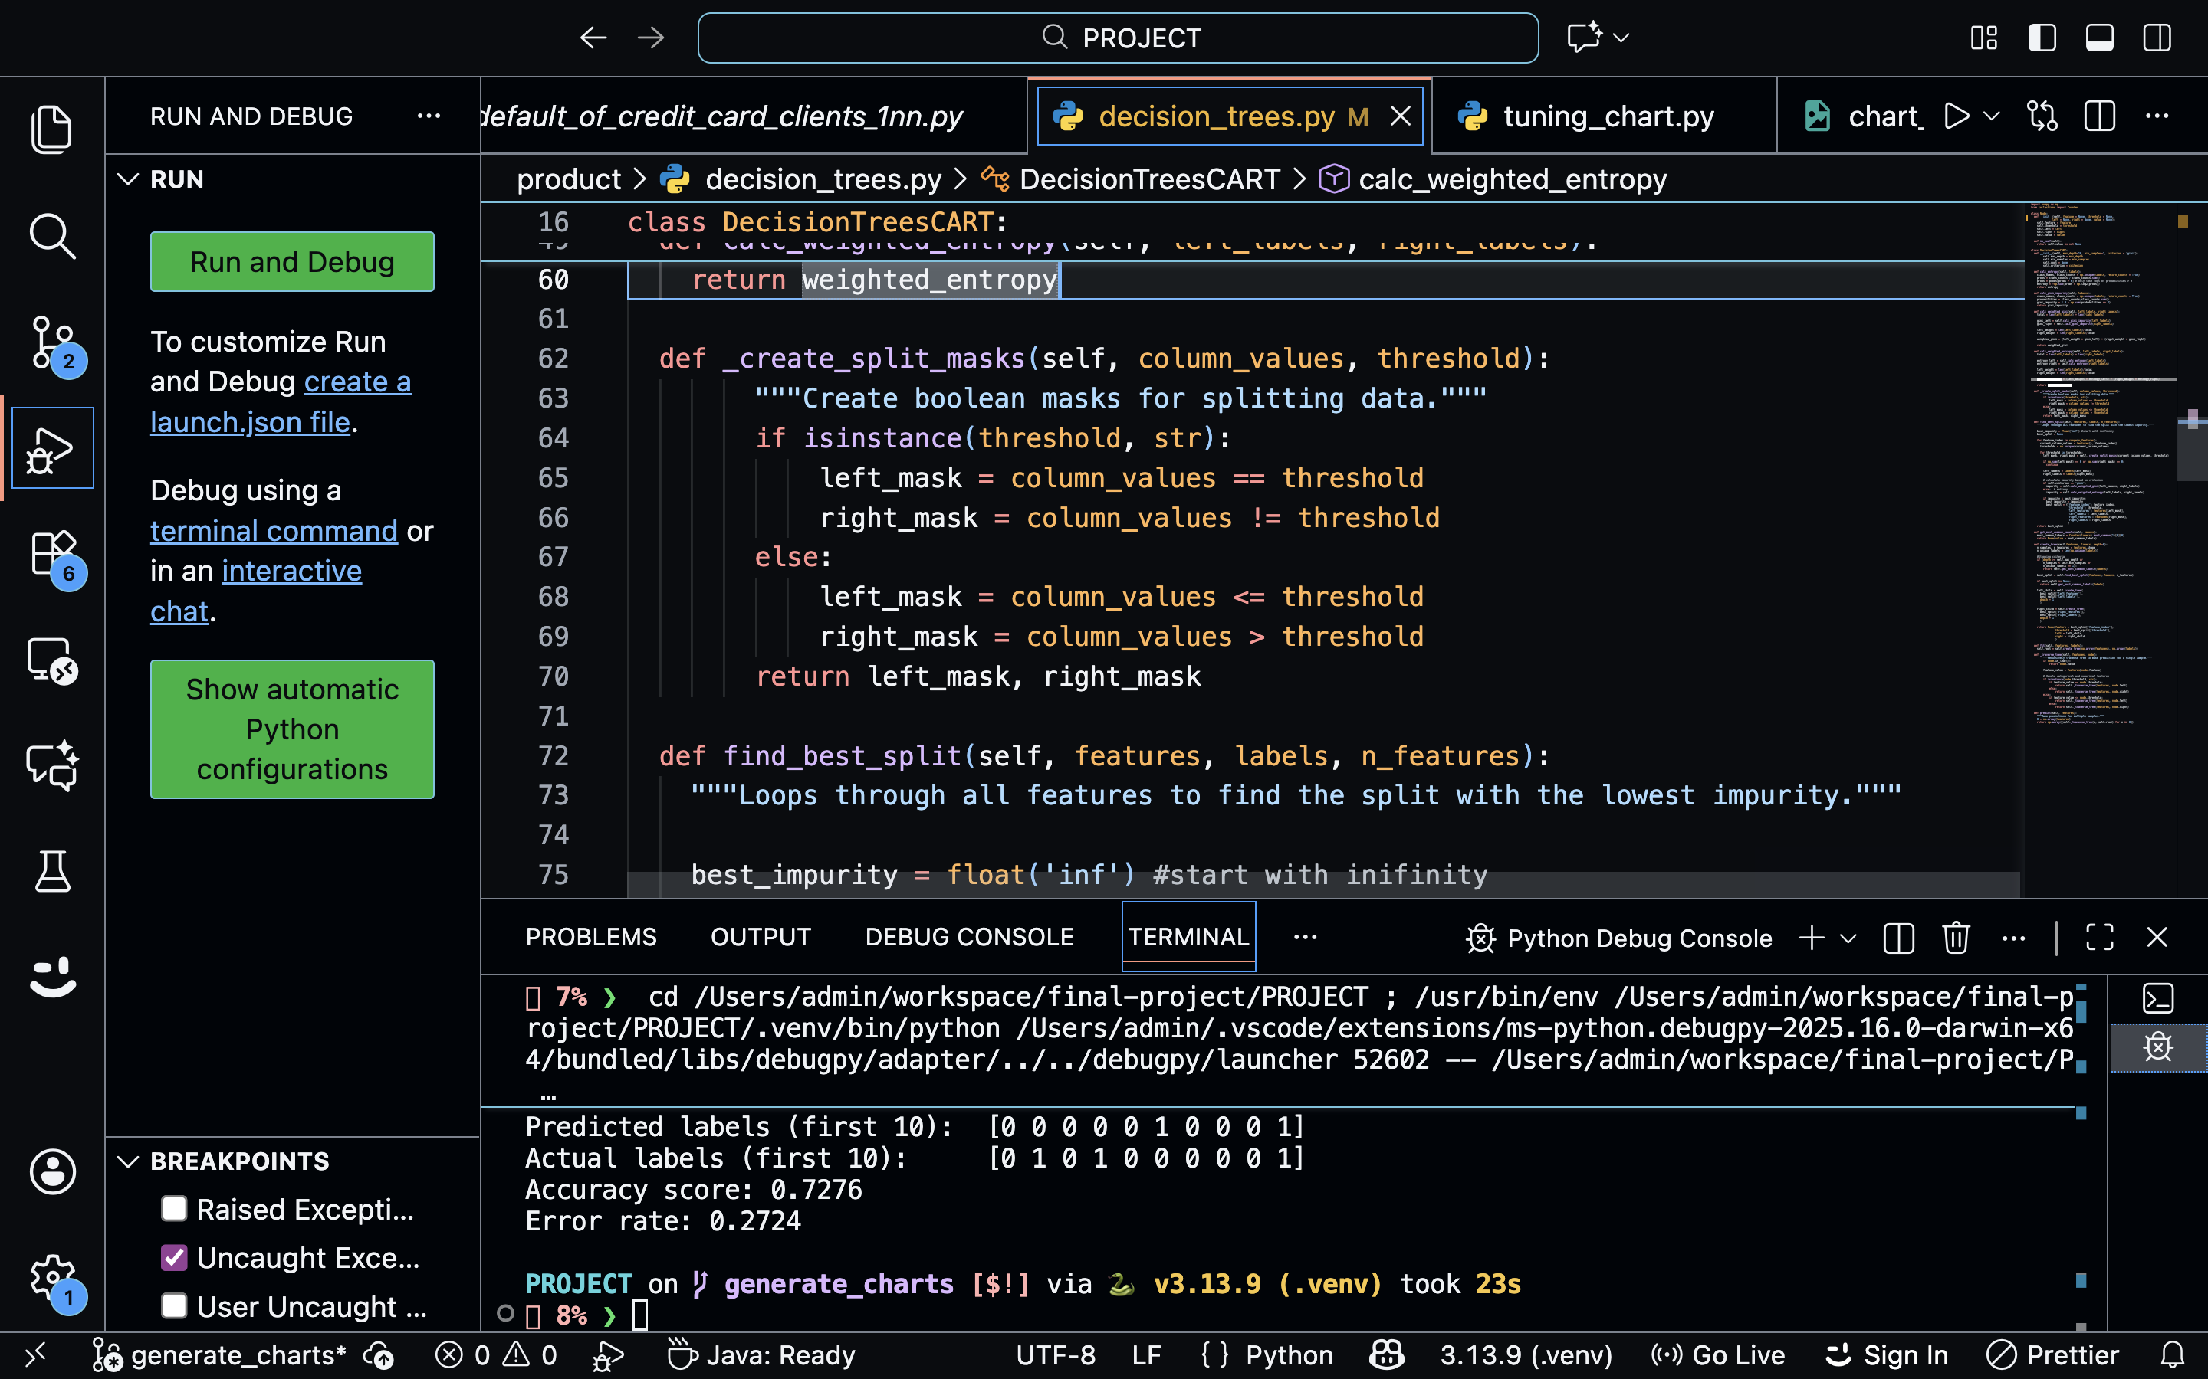
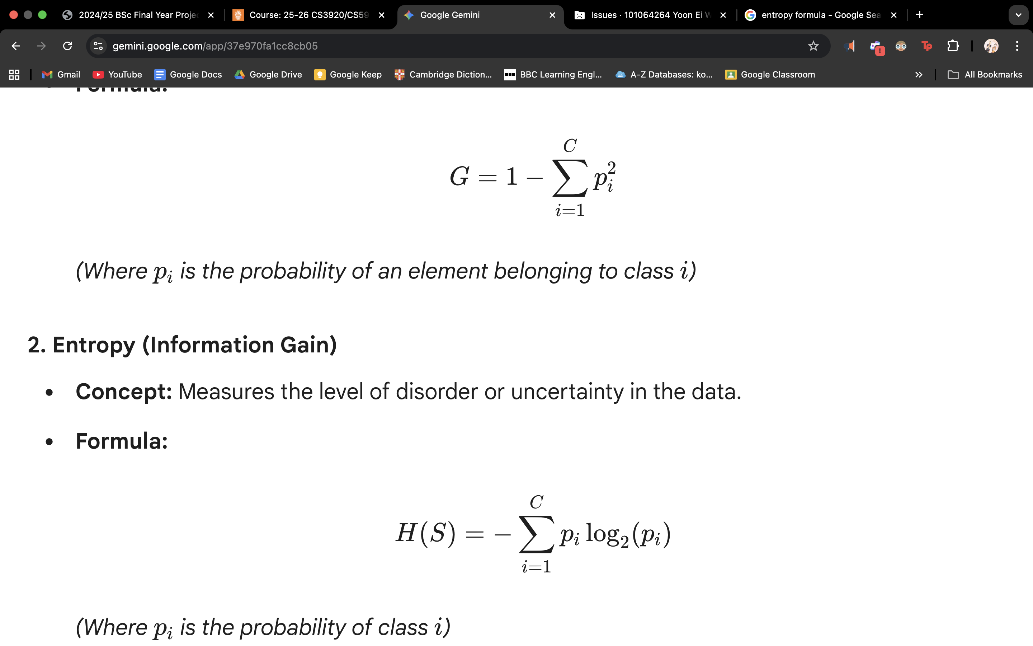
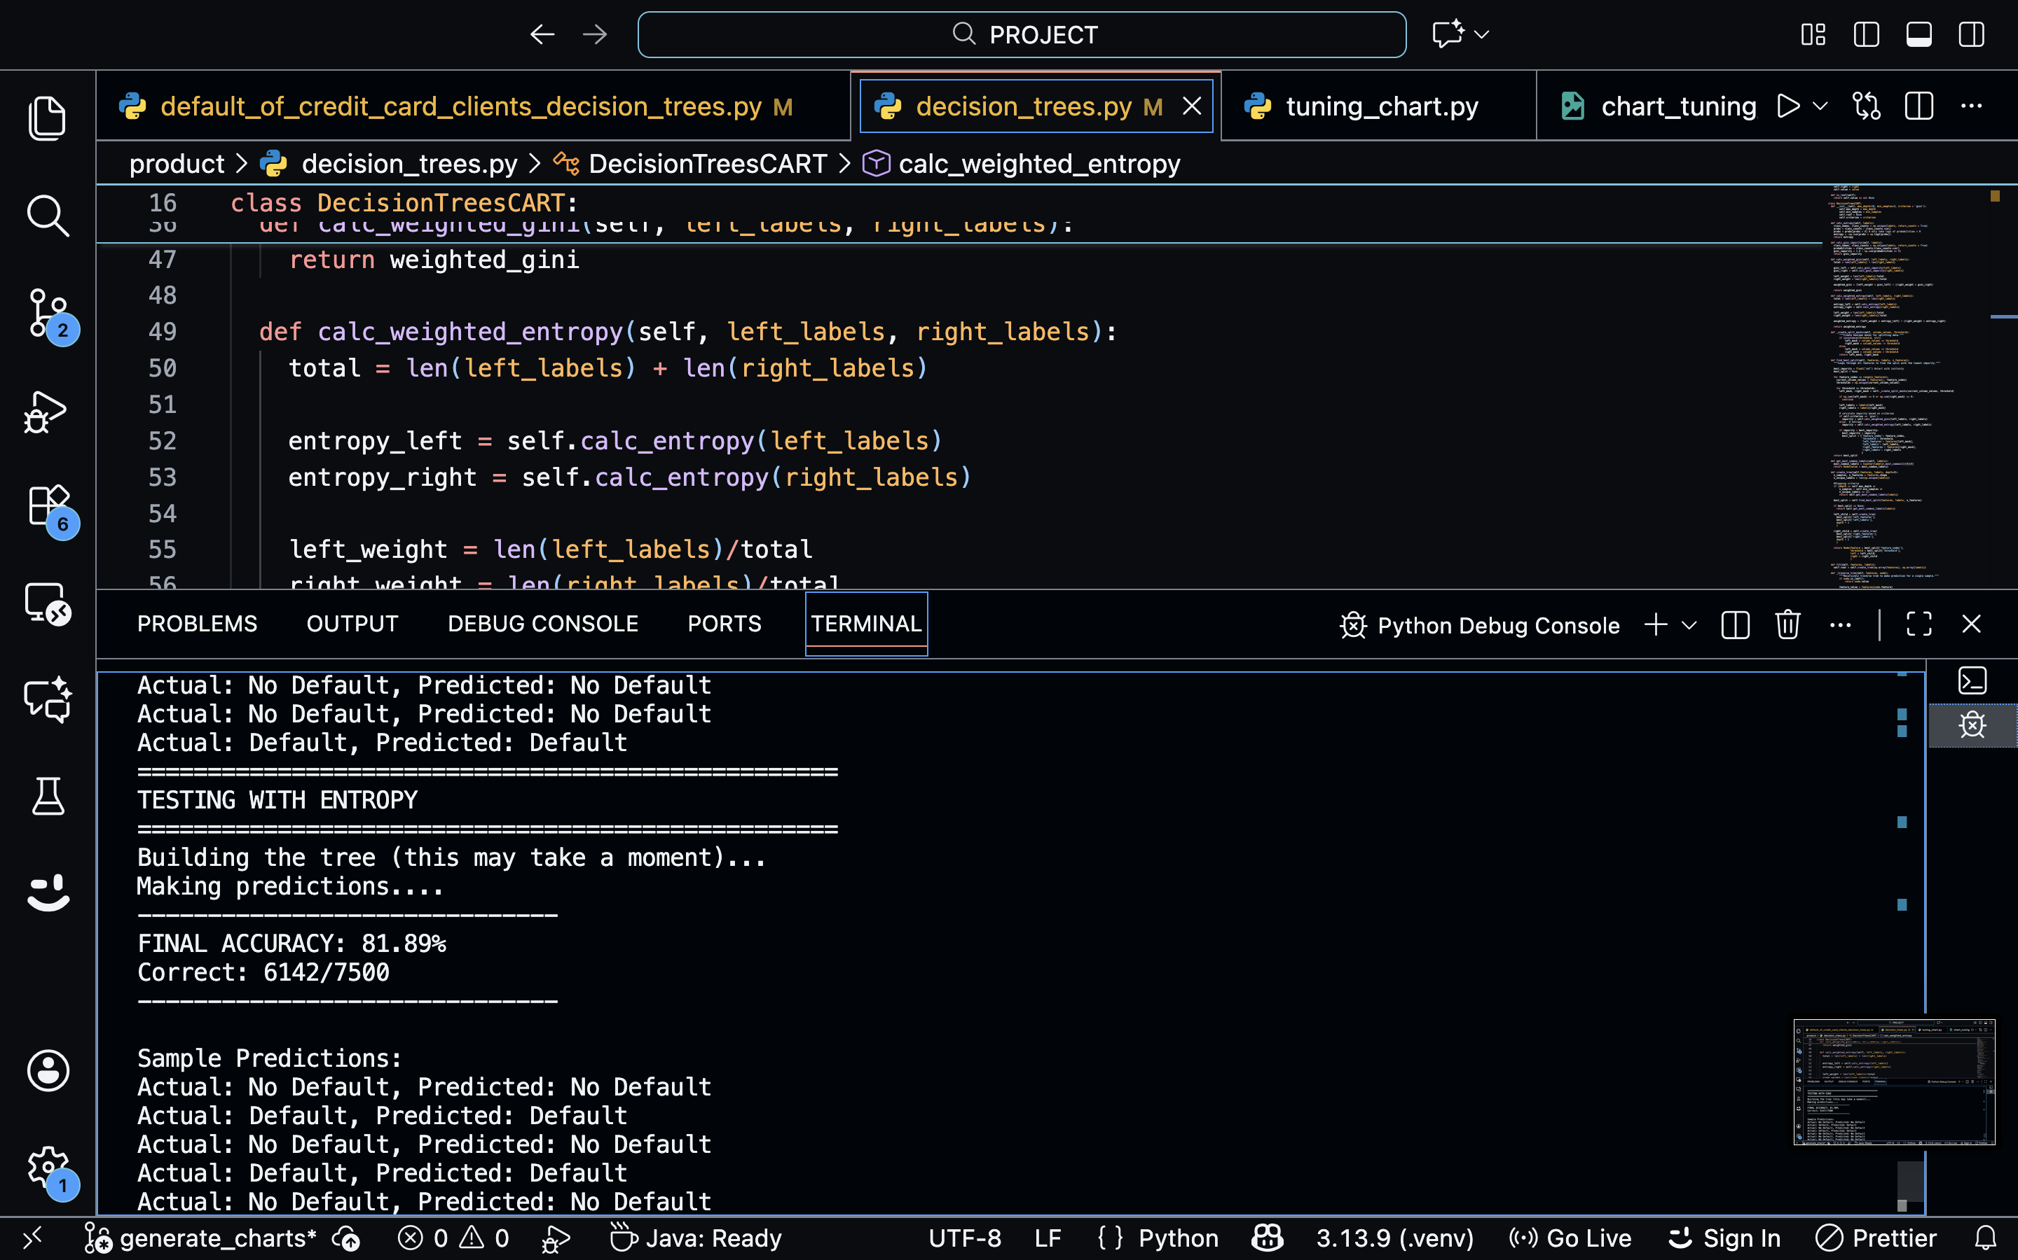
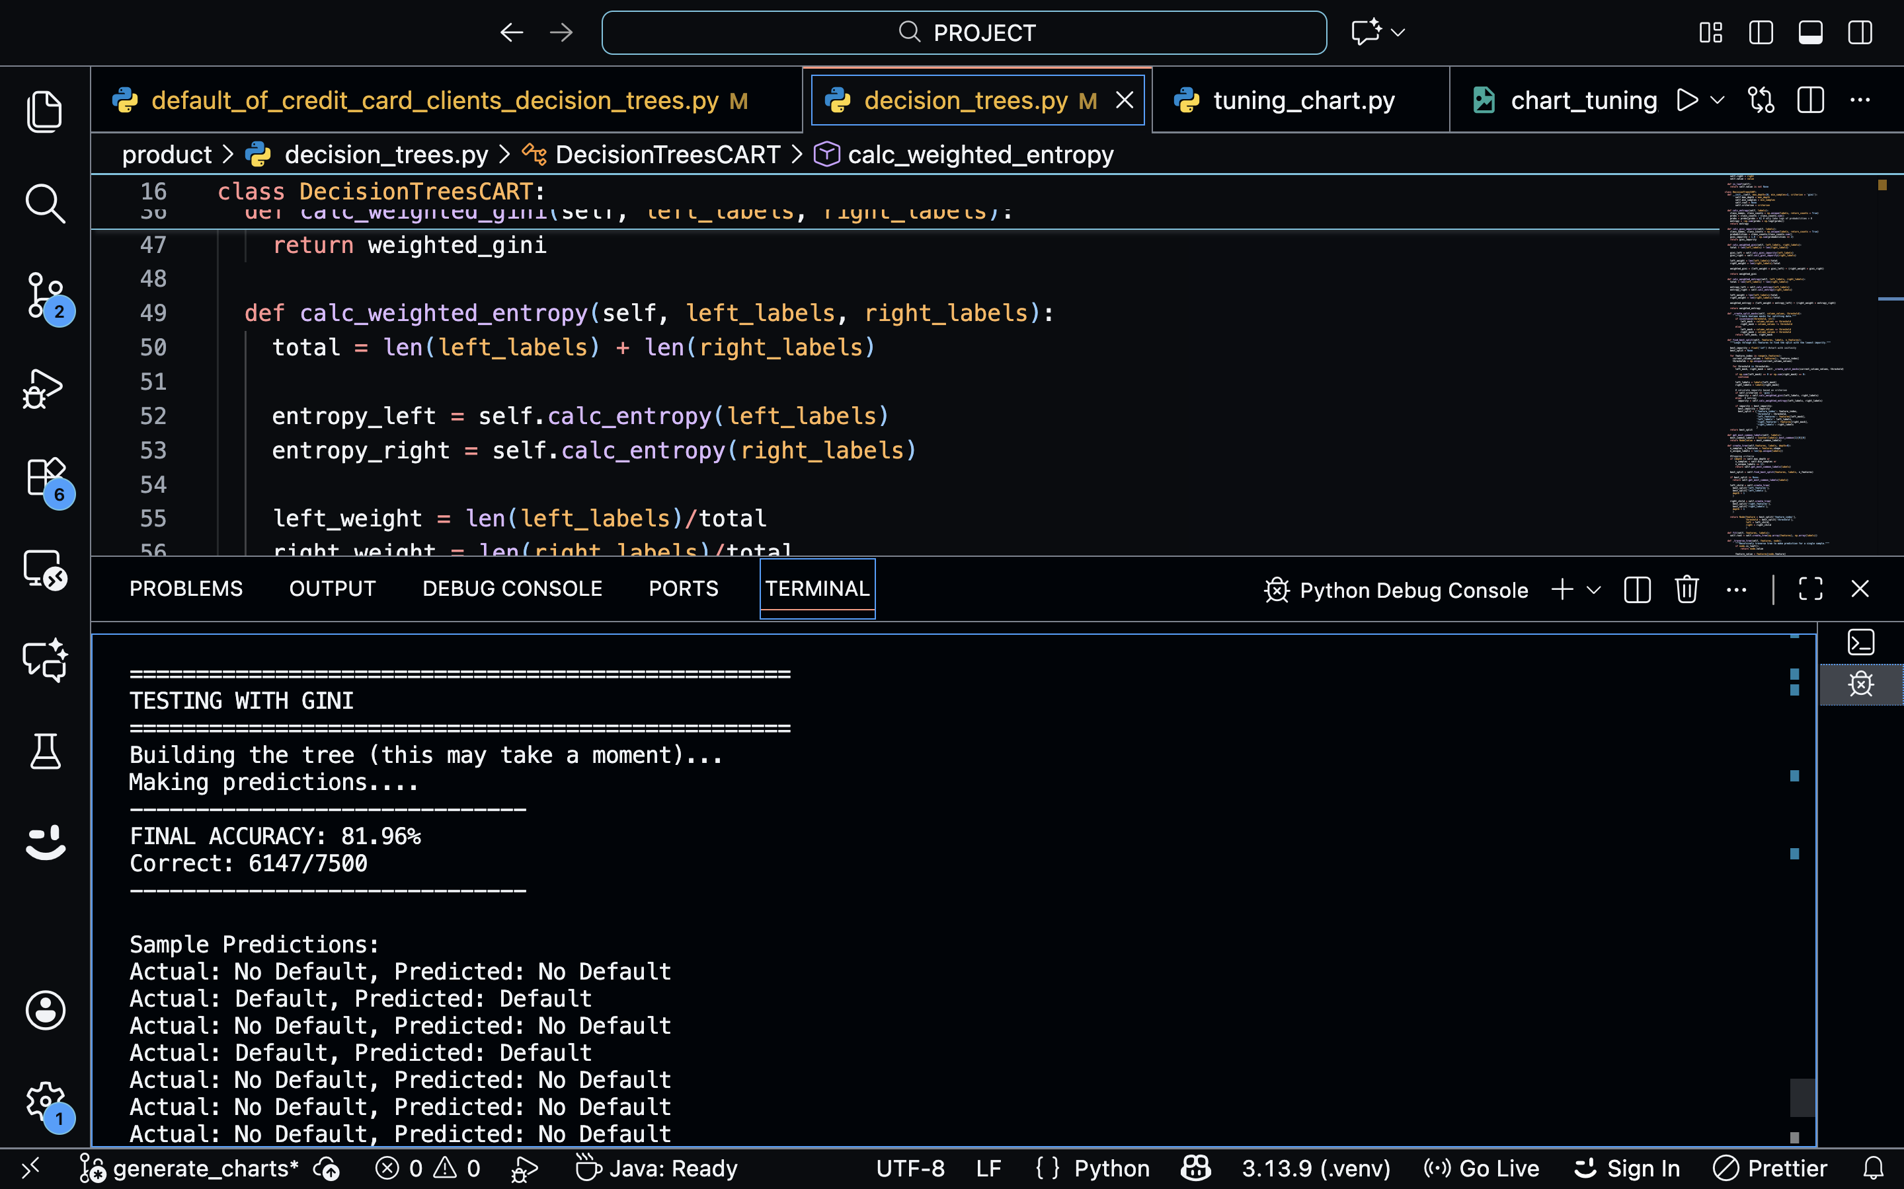
Decision Trees (CART Implementation)
Implementation: Recursive Object-Oriented CART (Classification and Regression Trees) from scratch
[ find_best_split() ]
|
--------------------------
| |
[Categorical] [Numerical]
(String) (Float)
| |
Equality Mask Threshold Mask
(Vectorized) (Vectorized)
PAY_1 <= 1
/ \
True False
(Low Risk) (High Risk)
/ \
PAY_2 <= 1 PAY_3 <= -1
Vectorized Boolean Masking Mechanism
Decision Trees Structure Sample
Measure of Uniformity Comparison
Gini Impurity
Shannon Entropy
Compared Gini Impurity vs. Entropy on the full dataset

Slide 9
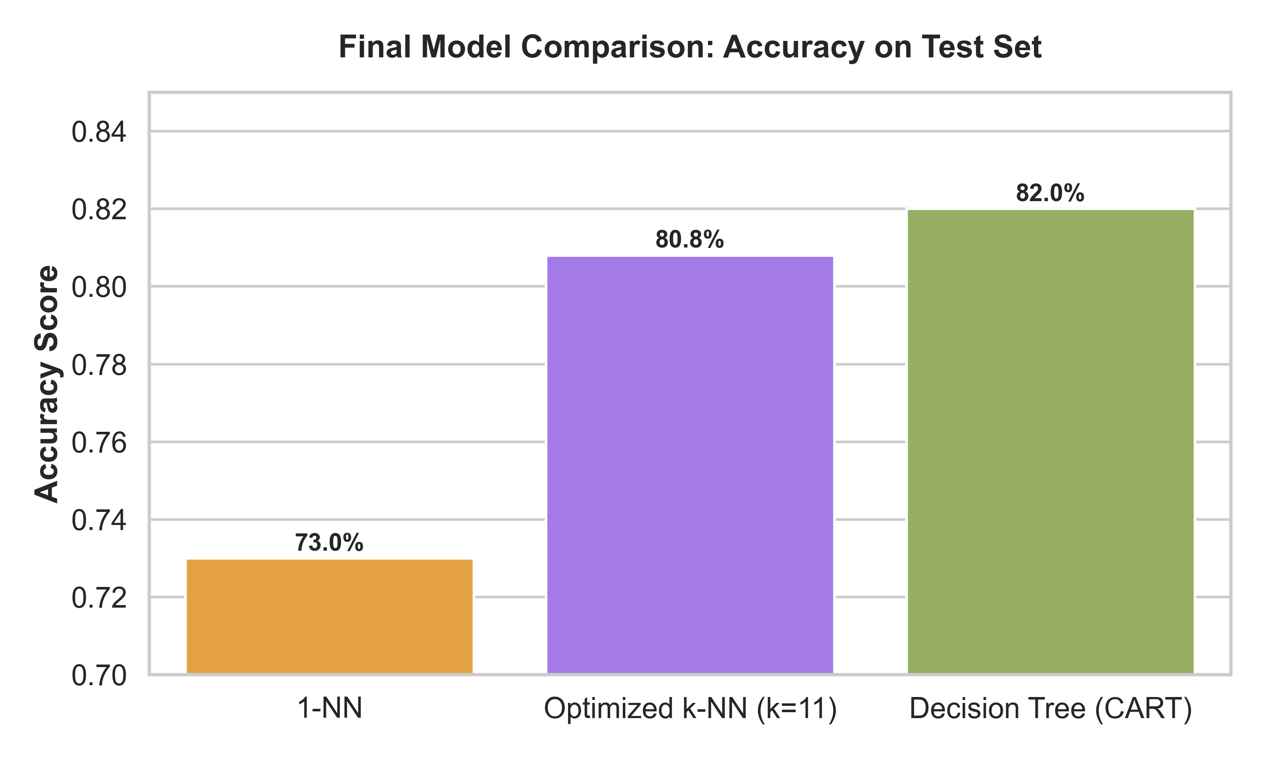
Final Evaluation and Roadmap
Future Work
Implement Support Vector Machines (SVM) & Kernel Methods
Replace Hold-Out with k-Fold Cross-Validation pipeline
Develop Graphical User Interface (GUI) for end-users
Tuning Impact: 7.0%+ improvement over baseline.

Slide 10
Thank you! Q & A Session

